Slide 1
Personal Indicators of Heart Disease
Which variables have a significant effect on the increased chance of heart disease?

Slide 2
Stakeholder
What variables predict Heart Disease and how could we use this to treat it?

Slide 3
Data Set
2020 annual CDC survey of over 9k adults related to their health status
Variables include BMI, smoking, alcohol drinking, physical health over 30 days, mental health over 30 days, difficulty walking, sex, age, race, if their diebetic, physical activity over 30 days, general health, sleep time per day, asthma, kidney disease, and skin cancer.
Source: “https://www.kaggle.com/datasets/kamilpytlak/personal-key-indicators-of-heart-disease”

Slide 4
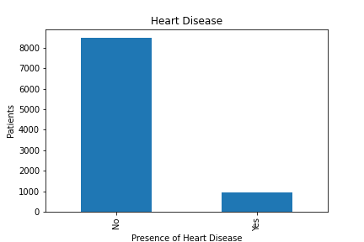
Visual analysis of Heart Disease
Shows consistent data
Significantly more people don’t have heart disease compared to those who do

Slide 5
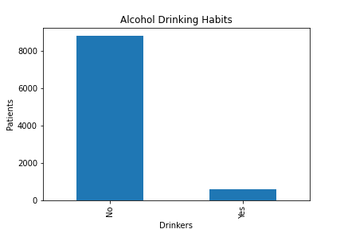
Visual analysis of Alcohol Drinking Habits
Visual of heavy drinkers: more than 14 drinks per week for men and more than 7 drinks per week for women
Significantly less heavy drinkers than non-heavy drinkers
Aligns with the presence of heart disease in our data

Slide 6
Limitations of model
False negative rate of 20 percent would mean those patients wouldn’t receive the care they needed for the presence of Heart Disease
False positive rate of 27 percent would mean those patients would be treated as if they had heart disease but in reality don’t
While the model is worse at predicting those who don’t have heart disease in this case I believe the benefits of it being better at predicting those who have heart disease outweighs the negatives.

Slide 7
Strengths of model
Predicted 80 percent of True Positives which means the majority of patients who have heart disease are getting treated for it
Predicted 73 percent of True Negatives.
Overall accuracy of 77 percent

Slide 8
Reccomendation
These variables are a good indicator of predicting heart disease so we should use the model to make sure patients are getting proper treatment
Can focus on variables that tend to lead to heart disease such as heavy alcohol consumption to prevent the disease in the future.

